Slide 1
Growing Curvilinear Component Analysis (GCCA)
G. Cirrincione
University of Picardie Jules Verne
Lab. LTI, Amiens, France
University of Nottingham
Dept. Electrical Eng., Nottingham, UK
exin@u-picardie.fr
V. Randazzo
Politecnico di Torino
DET, Torino, Italy
vincenzorandazzo@msn.com

Slide 2
Introduction
CCA
GCCA algorithm
Analysis of bridges
Simulations
Application
Conclusions

Slide 3
continuous
learning
online
data stream
introduction CCA GCCA algorithm analysis of bridges simulations application conclusions

Slide 4
online ISOMAP (2004)
GNLG-NG (2006)
TRNMap (2008)
RBF-NDR (2011)
connected
graph
PCA (Oja, 1992)
neural PCA :
GHA (1989)
APEX (1996)
VQ + P fusion
VQP (1993)
OVI-NG (2006)
incremental SOM :
GNG-U (1997)
DASH (2005)
DSOM (2010)
autoencoders (2006)
linear
nonlinear
stationary input
data stream
nonstationary input
linear
real time PR
fault diagnosis
novelty detection
intrusion detection
speech recognition
text recognition
computer vision
scene analysis
face recognition
nonlinear
PCA (Oja, 1992)
DSOM (2010)
forgetting network
introduction CCA GCCA algorithm analysis of bridges simulations application conclusions

Slide 5
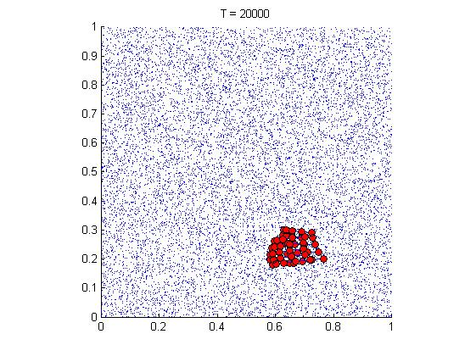
What is the goal ?

Slide 6
What is the goal ?

Slide 7
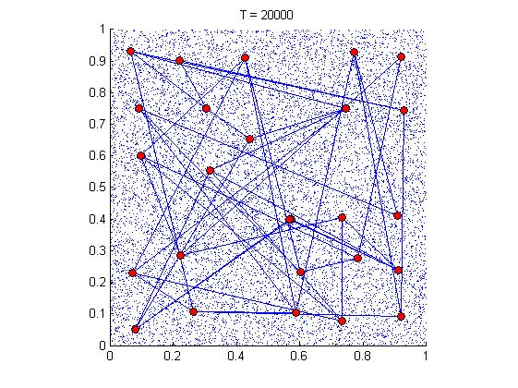
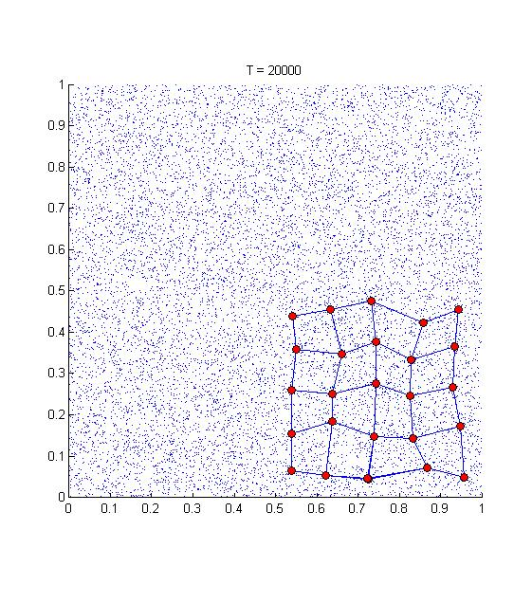
What is the goal ?
SOM with
low constant learningrate
SOM with high constant
learning rate
memoryless
DSOM
with high constant learning rate

Slide 8
What is the goal ?
memory
bridge
introduction CCA GCCA algorithm analysis of bridges simulations application conclusions

Slide 9
What is the goal ?
memory
bridge
nonstationary
(jump)
x
0
bridge
t = t
neuron
local
threshold
0
Competitive Hebbian Learning
T
first winner
edge
edge
n
second winner
t < t
0
introduction CCA GCCA algorithm analysis of bridges simulations application conclusions

Slide 10
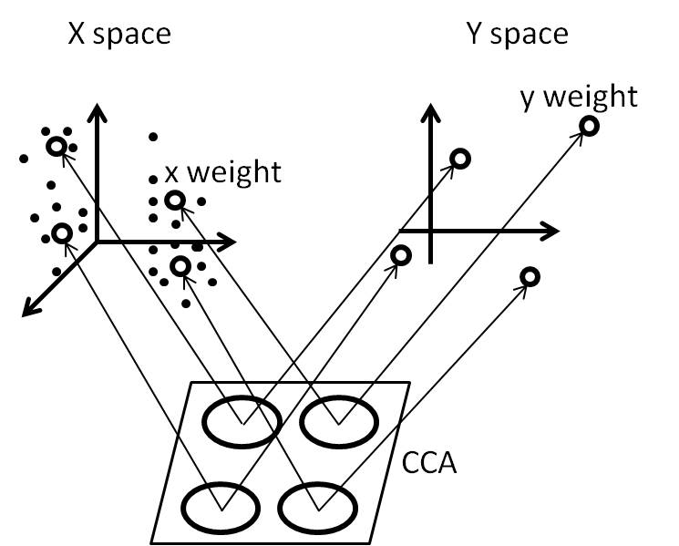
Curvilinear Component Analysis
projection
local
vector
quantization
dynamic
introduction CCA GCCA algorithm analysis of bridges simulations application conclusions

Slide 11
start
Network initialization with two neurons (initial seed)
seed
data space
latent space
GCCA algorithm
introduction CCA GCCA algorithm analysis of bridges simulations application conclusions

Slide 12
start
Create a new neuron in the X space whose weight vector is x₀
Network initialization with two neurons (initial seed)
New data x₀
Compute distances from existing neurons (candidate neurons)
Sort distances from min to max, say d₁,..,d_{n}
T_{w1} > d₁?
no
x
0
t = t
0
neuron threshold
T
W
nonstationary
(jump)
w
1
edge
n
t < t
0
introduction CCA GCCA algorithm analysis of bridges simulations application conclusions

Slide 13
start
Create a new neuron in the X space whose weight vector is x₀
Network initialization with two neurons (initial seed)
Link x₀ to w₁ with a bridge
New data x₀
Compute distances from existing neurons (candidate neurons)
Sort distances from min to max, say d₁,..,d_{n}
T_{w1} > d₁?
no
x
0
bridge
t = t
0
T
W
w
1
edge
n
t < t
0
introduction CCA GCCA algorithm analysis of bridges simulations application conclusions

Slide 14
start
Create a new neuron in the X space whose weight vector is x₀
Network initialization with two neurons (initial seed)
Link x₀ to w₁ with a bridge
New data x₀
Compute distances from existing neurons (candidate neurons)
ComputeT_{x0} =⎪⎢x₀-w₁ ⎪⎢
Sort distances from min to max, say d₁,..,d_{n}
T_{w1} > d₁?
no
x
0
bridge
t = t
0
T
W
w
1
edge
n
t < t
0
introduction CCA GCCA algorithm analysis of bridges simulations application conclusions

Slide 15
projection with extrapolation
(latent space)
start
Create a new neuron in the X space whose weight vector is x₀
Network initialization with two neurons (initial seed)
Link x₀ to w₁ with a bridge
New data x₀
Compute distances from existing neurons (candidate neurons)
ComputeT_{x0} =⎪⎢x₀-w₁ ⎪⎢
Triangulate initial y₀
Sort distances from min to max, say d₁,..,d_{n}
T_{w1} > d₁?
no
x
0
bridge
t = t
0
T
W
w
1
edge
n
t < t
0
introduction CCA GCCA algorithm analysis of bridges simulations application conclusions

Slide 16
projection with extrapolation
(latent space)
Create a new neuron in the X space whose weight vector is x₀
Link x₀ to w₁ with a bridge
ComputeT_{x0} =⎪⎢x₀-w₁ ⎪⎢
Triangulate initial y₀
farthest from the third winner
y
0
t >= t
0
d
1
w
d
1
2
w
w
2
3
t < t
0
introduction CCA GCCA algorithm analysis of bridges simulations application conclusions

Slide 17
projection with extrapolation
(latent space)
Create a new neuron in the X space whose weight vector is x₀
Link x₀ to w₁ with a bridge
ComputeT_{x0} =⎪⎢x₀-w₁ ⎪⎢
Triangulate initial y₀
extrapolation
Fix the first and the second winner and adjust y₀ according to CCA gradient flow for one iteration
y
0
t >= t
0
d
FIXED
1
w
d
1
2
w
w
2
3
FIXED
t < t
0
introduction CCA GCCA algorithm analysis of bridges simulations application conclusions

Slide 18
start
Create a new neuron in the X space whose weight vector is x₀
Network initialization with two neurons (initial seed)
Link x₀ to w₁ with a bridge
New data x₀
Compute distances from existing neurons (candidate neurons)
ComputeT_{x0} =⎪⎢x₀-w₁ ⎪⎢
Triangulate initial y₀
Sort distances from min to max, say d₁,..,d_{n}
Fix the first and the second winner and adjust y₀ according to CCA gradient flow for one iteration
T_{w1} > d₁?
no
x
0
bridge
t = t
0
T
W
w
1
edge
n
t < t
0
introduction CCA GCCA algorithm analysis of bridges simulations application conclusions

Slide 19
start
CHL: first and second winner linking (if not already linked)
Network initialization with two neurons (initial seed)
New data x₀
Compute distances from existing neurons (candidate neurons)
Sort distances from min to max, say d₁,..,d_{n}
T_{w1} > d₁?
yes
Is the connection w₁ w₂
a bridge?
no
Competitive Hebbian Learning
(input space)
introduction CCA GCCA algorithm analysis of bridges simulations application conclusions

Slide 20
start
CHL: first and second winner linking (if not already linked)
Network initialization with two neurons (initial seed)
New data x₀
second
winner
Compute distances from existing neurons (candidate neurons)
x
0
winner
Sort distances from min to max, say d₁,..,d_{n}
T_{w1} > d₁?
yes
Is the connection w₁ w₂
a bridge?
Competitive Hebbian Learning
(input space)
introduction CCA GCCA algorithm analysis of bridges simulations application conclusions

Slide 21
start
CHL: first and second winner linking (if not already linked)
Network initialization with two neurons (initial seed)
Increment first winner neighbor edge ages by one (neuron pruning)
New data x₀
second
winner
Compute distances from existing neurons (candidate neurons)
x
Set the edge age between first and second winner to 0
0
0
winner
+1
+1
Sort distances from min to max, say d₁,..,d_{n}
+1
+1
T_{w1} > d₁?
yes
Is the connection w₁ w₂
a bridge?
Competitive Hebbian Learning
(input space)
introduction CCA GCCA algorithm analysis of bridges simulations application conclusions

Slide 22
start
CHL: first and second winner linking (if not already linked)
Network initialization with two neurons (initial seed)
Increment first winner neighbor edge ages by one (neuron pruning)
New data x₀
Compute distances from existing neurons (candidate neurons)
x
Set the edge age between first and second winner to 0
0
winner
SCL on w₁ and its linked neighbors
Sort distances from min to max, say d₁,..,d_{n}
T_{w1} > d₁?
yes
Is the connection w₁ w₂
a bridge?
no
Soft Competitive Learning
(input space)
introduction CCA GCCA algorithm analysis of bridges simulations application conclusions

Slide 23
start
CHL: first and second winner linking (if not already linked)
Network initialization with two neurons (initial seed)
Increment first winner neighbor edge ages by one (neuron pruning)
New data x₀
Compute distances from existing neurons (candidate neurons)
x
Set the edge age between first and second winner to 0
0
SCL on w₁ and its linked neighbors
Sort distances from min to max, say d₁,..,d_{n}
T_{w1} > d₁?
yes
Is the connection w₁ w₂
a bridge?
no
Soft Competitive Learning
(input space)
introduction CCA GCCA algorithm analysis of bridges simulations application conclusions

Slide 24
start
CHL: first and second winner linking (if not already linked)
Network initialization with two neurons (initial seed)
Increment first winner neighbor edge ages by one (neuron pruning)
New data x₀
T_{w2}
Compute distances from existing neurons (candidate neurons)
Set the edge age between first and second winner to 0
SCL on w₁ and its linked neighbors
T_{w1}
Sort distances from min to max, say d₁,..,d_{n}
Compute T_{w1} and T_{w2}
T_{w1} > d₁?
yes
Is the connection w₁ w₂
a bridge?
no
neuron thresholding
(input space)
introduction CCA GCCA algorithm analysis of bridges simulations application conclusions

Slide 25
start
CHL: first and second winner linking (if not already linked)
Network initialization with two neurons (initial seed)
Increment first winner neighbor edge ages by one (neuron pruning)
New data x₀
Compute distances from existing neurons (candidate neurons)
Set the edge age between first and second winner to 0
SCL on w₁ and its linked neighbors
Sort distances from min to max, say d₁,..,d_{n}
Compute T_{w1} and T_{w2}
Detect neurons within the sphere in the Y space centered in the first winner and with radius λ (λ-neurons)
T_{w1} > d₁?
yes
Is the connection w₁ w₂
a bridge?
no
λ
projection with interpolation
(latent space)
introduction CCA GCCA algorithm analysis of bridges simulations application conclusions

Slide 26
start
CHL: first and second winner linking (if not already linked)
Network initialization with two neurons (initial seed)
Increment first winner neighbor edge ages by one (neuron pruning)
New data x₀
Compute distances from existing neurons (candidate neurons)
Set the edge age between first and second winner to 0
SCL on w₁ and its linked neighbors
Sort distances from min to max, say d₁,..,d_{n}
Compute T_{w1} and T_{w2}
Detect neurons within the sphere in the Y space centered in the first winner and with radius λ (λ-neurons)
T_{w1} > d₁?
yes
Is the connection w₁ w₂
a bridge?
no
Fix w₁ projection and adjust the λ-neurons according to CCA gradient flow for one iteration
FIXED
λ
projection with interpolation
(latent space)
introduction CCA GCCA algorithm analysis of bridges simulations application conclusions

Slide 27
start
CHL: first and second winner linking (if not already linked)
Network initialization with two neurons (initial seed)
Increment first winner neighbor edge ages by one (neuron pruning)
New data x₀
Compute distances from existing neurons (candidate neurons)
Set the edge age between first and second winner to 0
SCL on w₁ and its linked neighbors
Sort distances from min to max, say d₁,..,d_{n}
Compute T_{w1} and T_{w2}
Detect neurons within the sphere in the Y space centered in the first winner and with radius λ (λ-neurons)
T_{w1} > d₁?
yes
Is the connection w₁ w₂
a bridge?
no
Fix w₁ projection and adjust the λ-neurons according to CCA gradient flow for one iteration
FIXED
λ
yes
Is w₁ the bridge tail?
yes
Turn the bridge into a link
introduction CCA GCCA algorithm analysis of bridges simulations application conclusions

Slide 28
start
CHL: first and second winner linking (if not already linked)
Network initialization with two neurons (initial seed)
Increment first winner neighbor edge ages by one (neuron pruning)
New data x₀
Compute distances from existing neurons (candidate neurons)
Set the edge age between first and second winner to 0
SCL on w₁ and its linked neighbors
Sort distances from min to max, say d₁,..,d_{n}
Compute T_{w1} and T_{w2}
T_{w1} > d₁?
no
Detect neurons within the sphere in the Y space centered in the first winner and with radius λ (λ-neurons)
yes
Is the connection w₁ w₂
a bridge?
no
w₁ doubling (w_{1new} ) using HCL
Fix w₁ projection and adjust the λ-neurons according to CCA gradient flow for one iteration
yes
Is w₁ the bridge tail?
no
yes
Turn the bridge into a link
introduction CCA GCCA algorithm analysis of bridges simulations application conclusions

Slide 29
neuron
doubling
seed
W
T
W
1
W1
1new
edge
x
bridge
t >= t
1
0
w₁ doubling (w_{1new} ) using HCL
Link w₁ and w_{1new}
Compute T_{w1}= T_{w1new} = ⎪⎢w₁-w_{1new} ⎪⎢
w
edge
n
t < t
0
introduction CCA GCCA algorithm analysis of bridges simulations application conclusions

Slide 30
projection with extrapolation
(latent space)
W
W
1
1new
edge
x
bridge
t >= t
1
0
w₁ doubling (w_{1new} ) using HCL
Link w₁ and w_{1new}
Compute T_{w1}= T_{w1new} = ⎪⎢w₁-w_{1new} ⎪⎢
w
Triangulate y_{w1new}
edge
n
t < t
0
introduction CCA GCCA algorithm analysis of bridges simulations application conclusions

Slide 31
projection with extrapolation
(latent space)
farthest from the third winner
FIXED
W
W
1
1new
edge
bridge
t >= t
0
w₁ doubling (w_{1new} ) using HCL
Link w₁ and w_{1new}
FIXED
Compute T_{w1}= T_{w1new} = ⎪⎢w₁-w_{1new} ⎪⎢
w
Triangulate y_{w1new}
edge
Fix y_{w1} and y_{w2}
adjust y_{w1new} according to CCA gradient flow for one iteration
n
t < t
0
introduction CCA GCCA algorithm analysis of bridges simulations application conclusions

Slide 32
start
start
Create a new neuron in the X space whose weight vector is x₀
CHL: first and second winner linking (if not already linked)
Network initialization with two neurons (initial seed)
Increment first winner neighbor edge ages by one (neuron pruning)
Link x₀ to w₁ with a bridge
New data x₀
New data x₀
Compute distances from existing neurons (candidate neurons)
ComputeT_{x0} =⎪⎢x₀-w₁ ⎪⎢
Set the edge age between first and second winner to 0
Triangulate initial y₀
SCL on w₁ and its linked neighbors
Sort distances from min to max, say d₁,..,d_{n}
Fix the first and the second winner and adjust y₀ according to CCA gradient flow for one iteration
Compute T_{w1} and T_{w2}
no
T_{w1} > d₁?
no
Detect neurons within the sphere in the Y space centered in the first winner and with radius λ (λ-neurons)
T_{w1} > d₁?
yes
yes
Is the connection w₁ w₂
a bridge?
no
w₁ doubling (w_{1new} ) using HCL
Fix w₁ projection and adjust the λ-neurons according to CCA gradient flow for one iteration
Link w₁ and w_{1new}
yes
Compute T_{w1}= T_{w1new} = ⎪⎢w₁-w_{1new} ⎪⎢
Is w₁ the bridge tail?
no
Triangulate y_{w1new}
yes
Fix y_{w1} and y_{w2}
adjust y_{w1new} according to CCA gradient flow for one iteration
Turn the bridge into a link
t < t
0
introduction CCA GCCA algorithm analysis of bridges simulations application conclusions

Slide 33
Analysis of bridges
nonstationary: jump
t >= t
0
The jump is detected by the bridges
t < t
0
introduction CCA GCCA algorithm analysis of bridges simulations application conclusions

Slide 34
Analysis of bridges
nonstationary: jump
t >= t
0
t < t
0
The jump is detected by the bridges
introduction CCA GCCA algorithm analysis of bridges simulations application conclusions

Slide 35
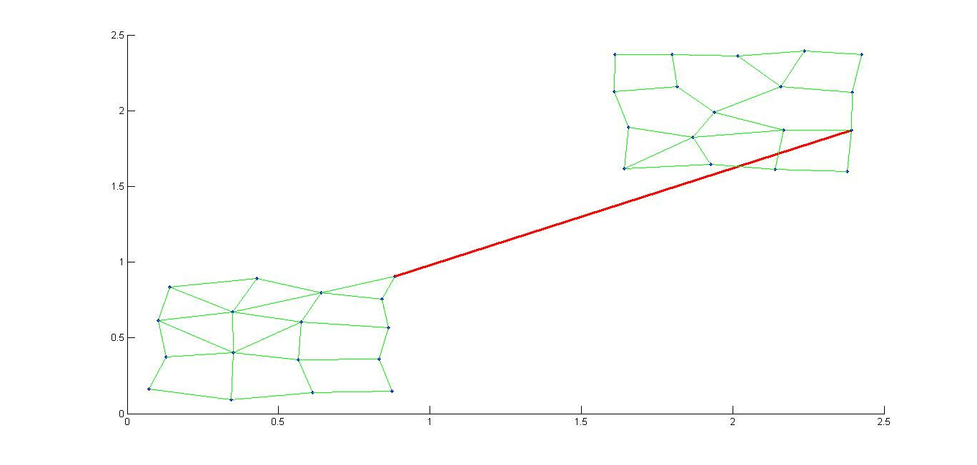
Analysis of bridges
nonstationary: jump
introduction CCA GCCA algorithm analysis of bridges simulations application conclusions

Slide 36
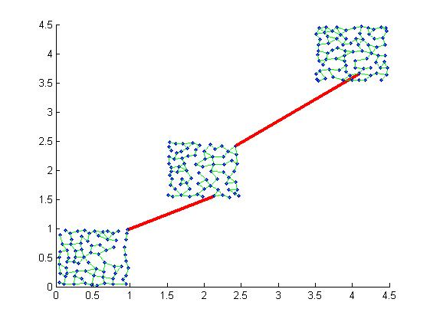
Analysis of bridges
nonstationary: jump
introduction CCA GCCA algorithm analysis of bridges simulations application conclusions

Slide 37
Analysis of bridges
nonstationary:
smooth displacement
possible bridges in the upper area
no bridges in the overlap area
t
2
t
1
The density of bridges is proportional to the displacement velocity of the distribution
introduction CCA GCCA algorithm analysis of bridges simulations application conclusions

Slide 38
Analysis of bridges
nonstationary:
very slow displacement
Only the border neurons win the competition and move in average in the direction of the displacement. The other neurons are static. Very slow displacement implies no bridges.
displacement
introduction CCA GCCA algorithm analysis of bridges simulations application conclusions

Slide 39
Analysis of the bridge:
length
If the length of the bridge is great, there are two interpretations :
link
new neuron
new neuron
no link
double neuron
bridge
bridge
old neuron
old neuron
Novelty detection
Outlier (bridge pruning)
introduction CCA GCCA algorithm analysis of bridges simulations application conclusions

Slide 40
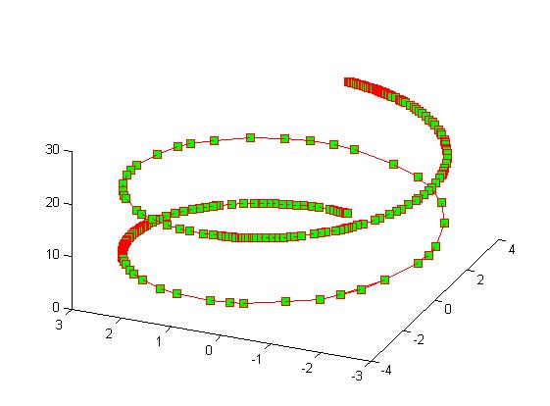
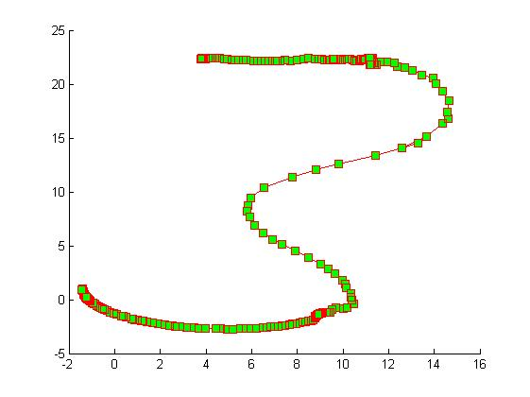
Simulations
data space
latent space
introduction CCA GCCA algorithm analysis of bridges simulations application conclusions

Slide 41
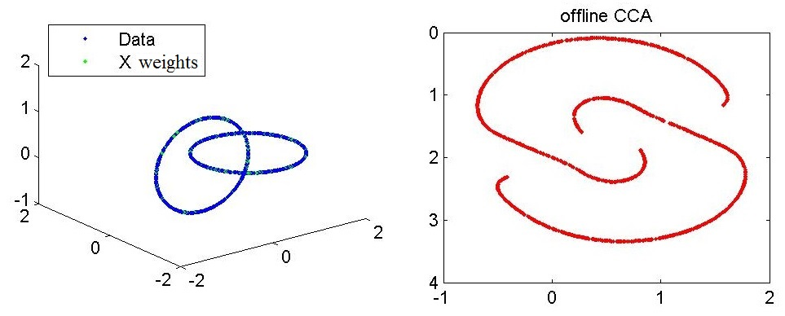
Simulations
simplified onCCA
no seeds
no bridges
no double neurons
introduction CCA GCCA algorithm analysis of bridges simulations application conclusions

Slide 42
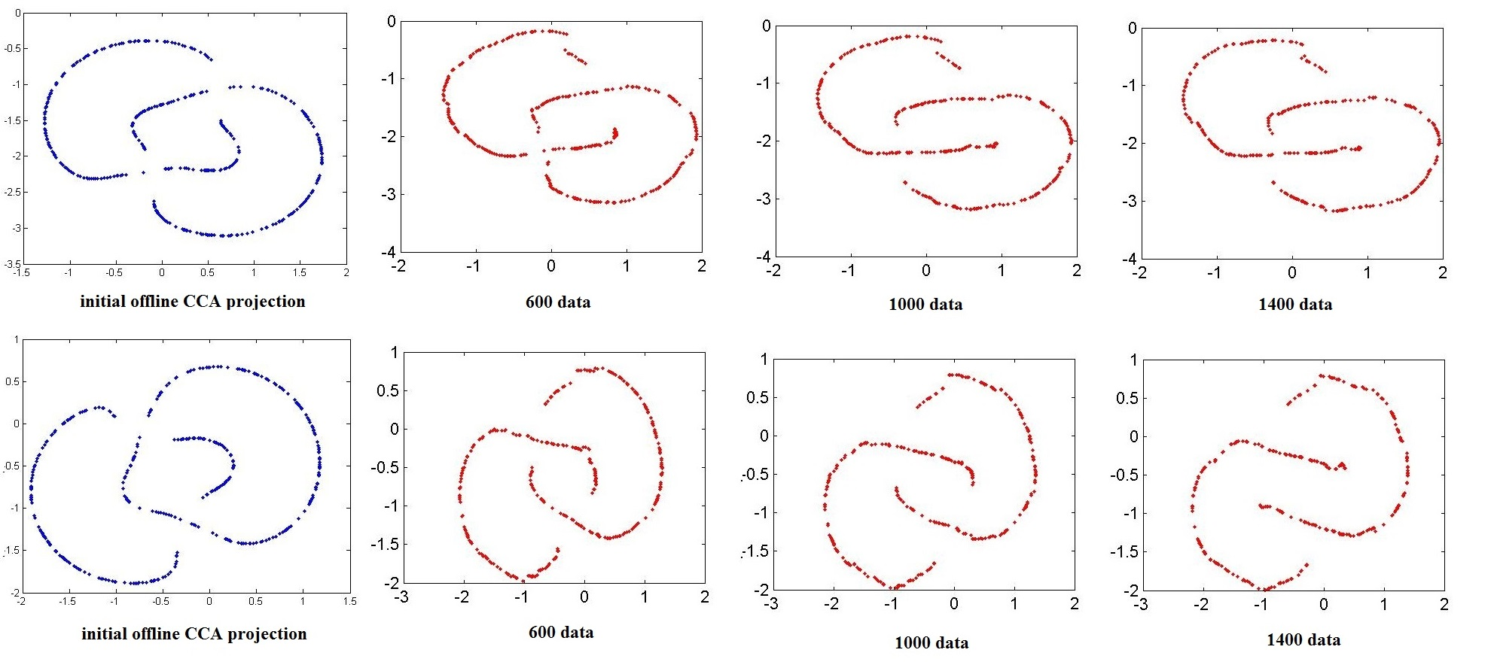
Simulations
simplified onCCA
good initial conditions
bad initial conditions
introduction CCA GCCA algorithm analysis of bridges simulations application conclusions

Slide 43
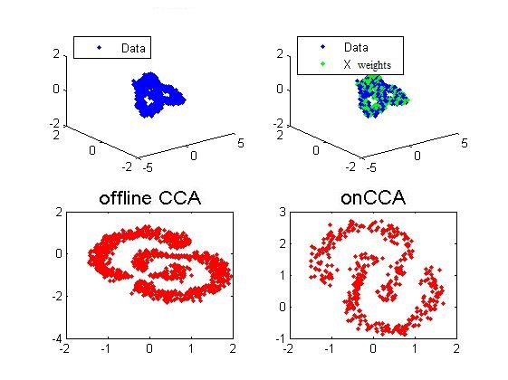
Simulations
simplified onCCA
noisy data
introduction CCA GCCA algorithm analysis of bridges simulations application conclusions

Slide 44
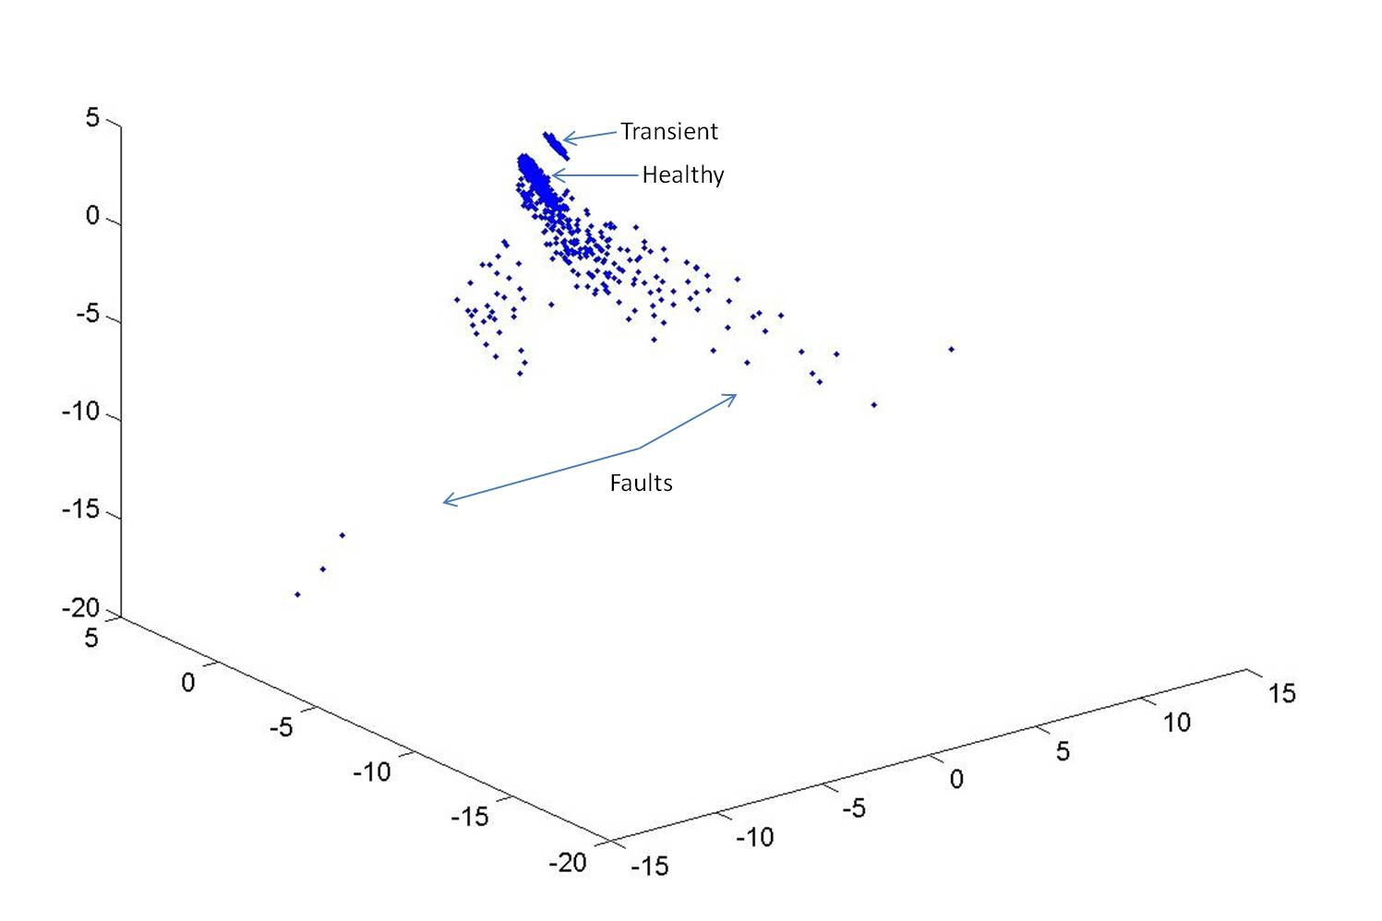
Application
NASA data repository : experiments on bearings' accelerated life tests provided by FEMTO-ST Institute, Besancon, France
2155 5-dimensional vectors whose components correspond to statistical features extracted by measurements drawn from four vibration transducers installed in a kinematic chain of an electrical motor
CCA
nonstationary framework evolving from the healthy state to a double fault occurring in the inner-race of a bearing and in the ball of another bearing
Intrinsic dim = 3
introduction CCA GCCA algorithm analysis of bridges simulations application conclusions

Slide 45
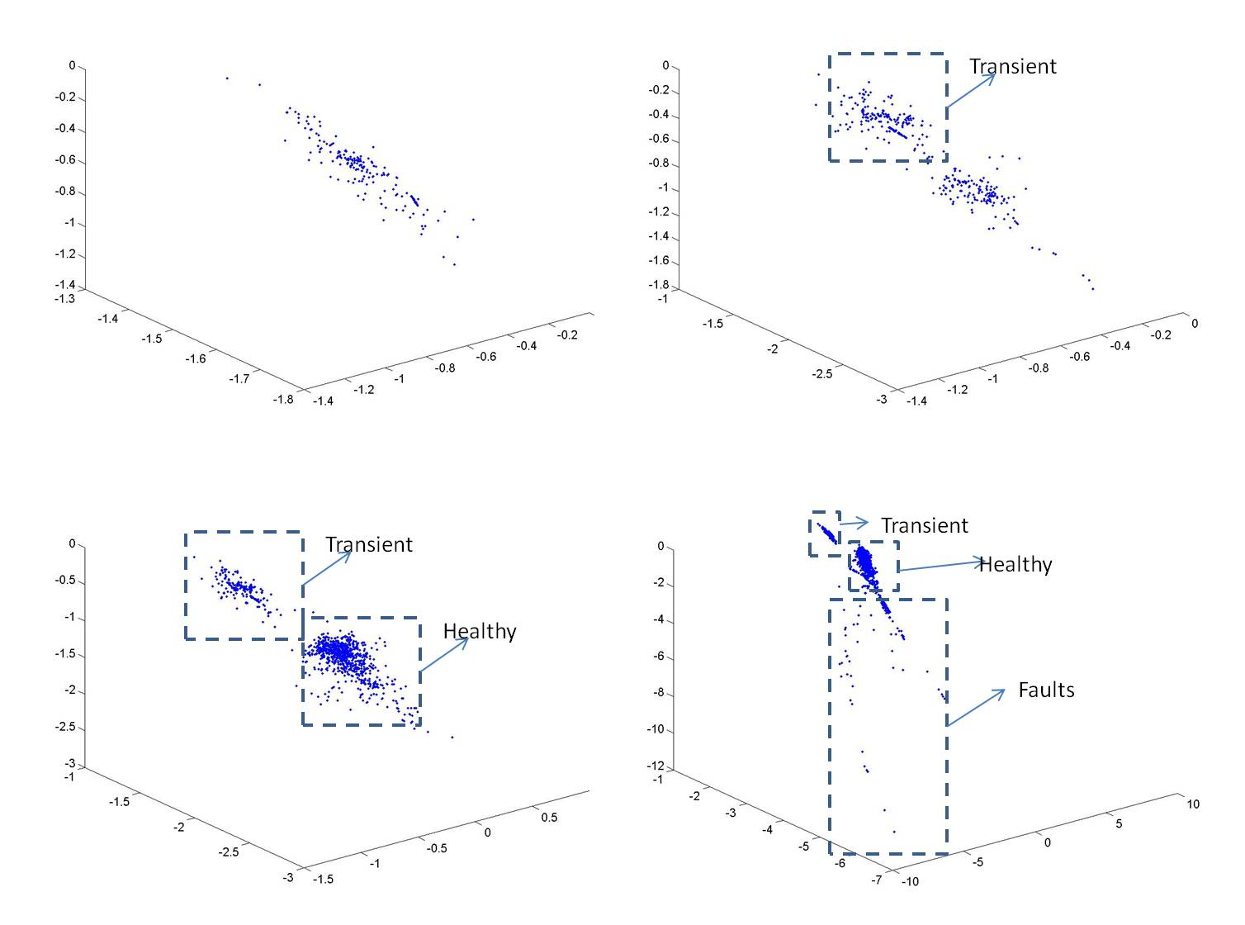
Application
simplified onCCA
introduction CCA GCCA algorithm analysis of bridges simulations application conclusions

Slide 46
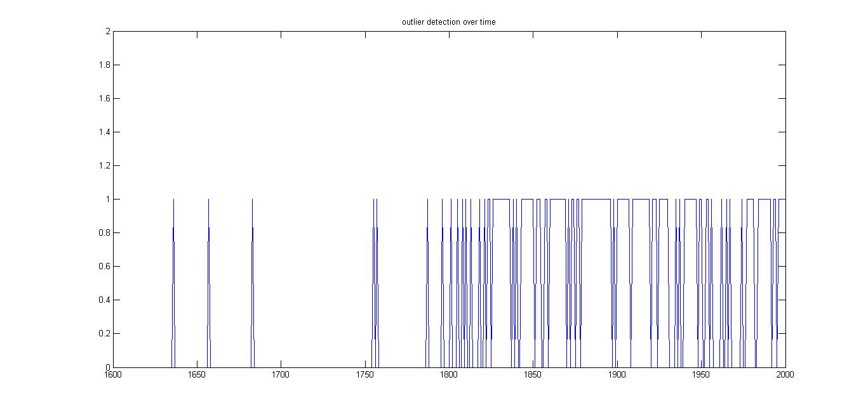
Application
simplified onCCA
novelty detection by means of the outlier frequency
fault onset
introduction CCA GCCA algorithm analysis of bridges simulations application conclusions

Slide 47
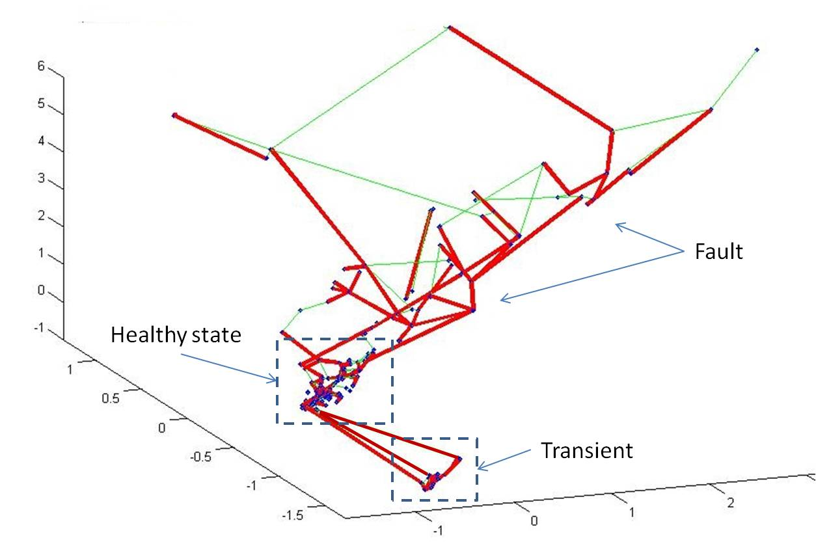
Application
GCCA
introduction CCA GCCA algorithm analysis of bridges simulations application conclusions

Slide 48
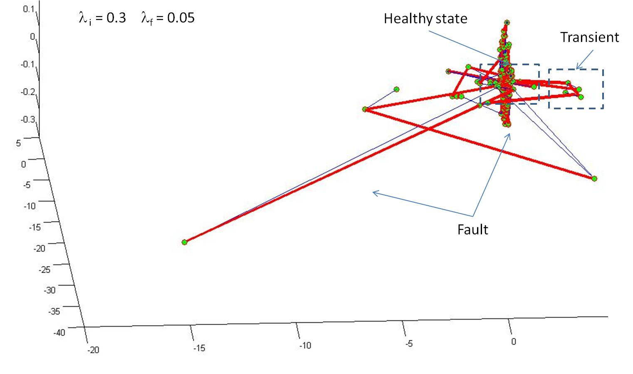
Application
latent space
introduction CCA GCCA algorithm analysis of bridges simulations application conclusions

Slide 49
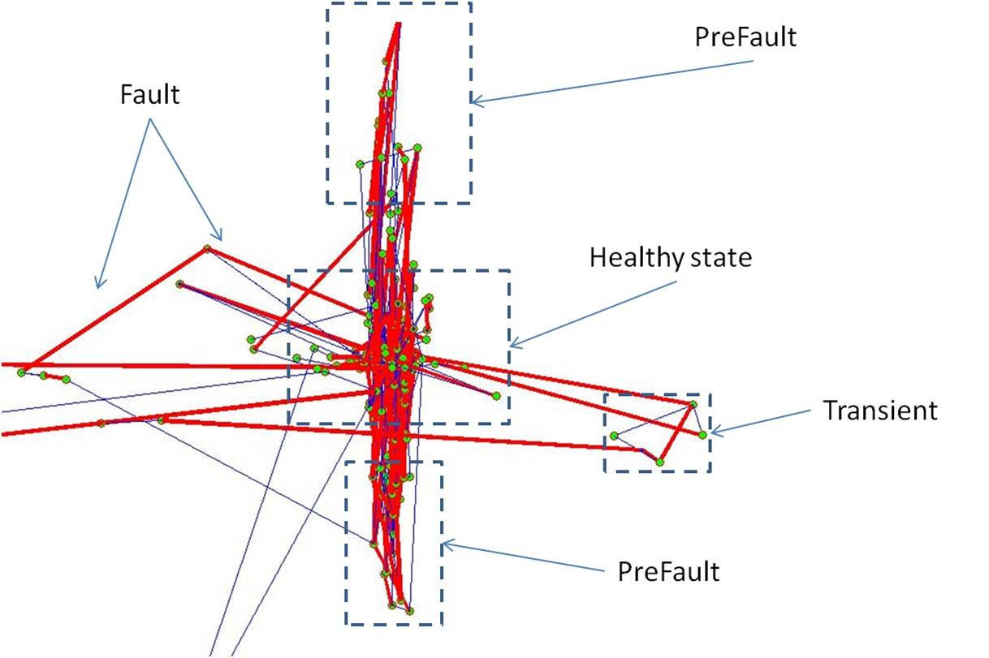
Application
latent space
introduction CCA onCCA algorithm analysis of bridges simulations application conclusions

Slide 50
Conclusions
λ coordination
seed
local
bridge
colonization
euclidean geodesic equivalence
nonstationary
topology preserving
distance preserving
outlier
introduction CCA GCCA algorithm analysis of bridges simulations application conclusions

Slide 51
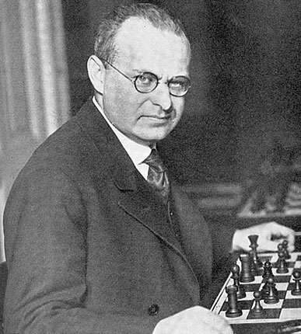
Aaron Nimzowitsch (1886-1935)

Slide 52
Local interpolation with λ neurons and geodesic distances
winner
projection
(FIXED)
λ
w
1
second order
projection
edges have been computed in the input space (CHL)
the λ neurons are selected by using the sphere centered at the winner projection
the λ neurons belong to the same tree
the distances in the input space are estimated by means of the geodesic distances
the distances in the latent space are estimated by means of the Euclidean distances

Slide 53
Local interpolation with λ neurons and geodesic distances
winner
projection
(FIXED)
λ
w
1
second order
projection
edges have been computed in the input space (CHL)
the λ neurons are selected by using the sphere centered at the winner projection
the λ neurons belong to the same tree
the distances in the input space are estimated by means of the geodesic distances
the distances in the latent space are estimated by means of the Euclidean distances

Slide 54
Local interpolation with λ neurons and geodesic distances
winner
projection
(FIXED)
λ
w
1
second order
projection
edges have been computed in the input space (CHL)
the λ neurons are selected by using the sphere centered at the winner projection
the λ neurons belong to the same tree
the distances in the input space are estimated by means of the geodesic distances
the distances in the latent space are estimated by means of the Euclidean distances

Slide 55
Local interpolation with λ neurons and geodesic distances
w
2
winner
projection
(FIXED)
λ
w
1
second order
projection
This technique is also used in case of bridges, which behave as edges between trees
(it helps estimating the relative position of trees in the latent space)

