Slide 1
Molecular Graph Generation with Graph Neural Networks
SAILAB Meeting 09-02-2020
Pietro Bongini

Slide 2
Graph Generation
Generative algorithms for graphs have many potential applications
Unlike image generation, graph generation is a discrete process
Graph generation has seen major developments only in the last few years
There are many different approaches to face this kind of problem

Slide 3
Graph Generators
Classical methods rely on hard-wired rules and randomness (Erdős-Renyi, Watts-Strogatz, Barabasi-Albert).
Variational AutoEncoders (VAEs) generate graphs by sampling their vectorial representations in a latent space. A graph is obtained by decoding each latent vector into a connectivity matrix, a node feature matrix, and an edge feature matrix.
Sequential models rely on recurrent networks, GAN-like mechanisms, reinforcement learning, or other methods, to generate the graph step by step.

Slide 4
GNN Graph Generators
GNNs could provide a good engine for a sequential model.
Recurrent models look at their past decisions to take the next step. GNNs can instead look at the partial result (the subgraph generated so far), which is more informative.
With respect to VAEs, that generate each graph in one shot, it is easier to build an interpretable stepwise generative process.

Slide 5
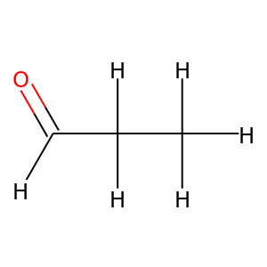
Molecule Generation
Molecules are usually represented as undirected graphs: atoms correspond to nodes and bonds correspond to edges.

Slide 6
QM9 Dataset
Dataset of 134k molecules from the GDB-17 theoretical enumeration (a “chemical universe” of 166 billion organic molecules)
5 atom types (CHNOF)
3 bond types (Single, double, triple)
The objective is to generate new molecules (not found in QM9) which are chemically valid
New molecules should have similar chemical properties with respect to a held-out test set (proof of generalization)

Slide 7
Generative Algorithm
Generation starts from a graph composed of a single atom (sampled from the training set distribution). Each step is a standalone problem.
1
1
8
1
5
0
0
0
…
4
0
3
7
9
2
6
2

Slide 8
Generative Algorithm
Each step is split into three subproblems
1
4
P1: Do I generate another neighbour for node 3? Of which type?
0
3
2
5
P2: Which is the type of bond (3,6)?
1
4
0
3
6
P3: Do I generate any extra bond: (0,6), (1,6), (2,6), (4,6), (5,6)?
2
5

Slide 9
GNN Modules
Each step is split into three subproblems
1
4
P1: A node-classifier GNN is asked to predict the next neighbour of node 3: (C, H, N, O, F, Stop). If the answer is «Stop», jump to node 4.
0
3
2
5
P2: Otherwise, an edge-classifier GNN is asked to predict the type of bond (3,6): (I, II, III).
1
4
0
3
6
P3: An edge predictor GNN decides if any extra bonds should be generated for the new node (and of which type).
2
5

Slide 10
Algorithm Chart
Generation of a graph G:
G=(V,E)
V: Vertex Set
E: Edge Set
Q: Expansion Queue
S: Starting Distribution
P1: Choose if to generate neighbor, and its type.
P2: Choose edge type
P3: Choose which edges to generate, and their types.
Initial conditions: E= {}, V={0}, type of vertex 0 sampled from training set, i=1, Q={0}.
BEGIN
TERMINATE
True
Focus on Q[0]
False
Q={}?
P1
Stop
Drop Q[0]
Tv
Add i to V, Q Assign Tv to i
P2
Te
i = i+1
Add (i, Q[0]) to E, type Te
Set E’
Add set E’ to E
P3

Slide 11
Stochastic GNN Generators
We have three GNN classifiers that should learn a discrete stochastic distribution each
Problem: regular neural network classifiers are not good at discrete stochastic distributions [1][2]
Hardmax or a regular softmax cannot help
Solution: a Gumbel Softmax output layer [1] allows to backpropagate through units with stochastic behavior
Some other applications [4][5][6][7]

Slide 12
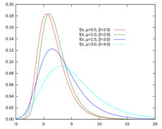
Gumbel Softmax
Like a regular softmax, it estimates the probability of each class, given the input sample x: P(C_{i} |x)
i.i.d. noise samples N are drawn from a Gumbel distribution [3] and added to the class probabilities
The class with highest P’_{i} = P(C_{i} |x) + N_{i} is chosen
The probability of assigning class i to x is equal to P(C_{i} | x), at softmax temperatute T=1
P’ will tend to a uniform distribution for T -> ∞, and to an hardmax for T -> 0

Slide 13
Gumbel Softmax Classifier
100 identical examples
Gumbel Softmax
Regular Softmax
P(C_{i}|x)
0.6
P(C_{i}|x)
0.6
0.3
0.3
0.1
0.1
i.i.d Gumbel Noise
A
B
C
A
B
C
60% of examples is assigned to class B, 30% to class C, 10% to class A.
B has the highest probability, every example is assigned to class B.

Slide 14
Generation Step Example
2
Generate Neighbor?
2
1
0
P1
C
1
0
4
H
N
3
O
3
GNN M1
F
Partial graph at step i
STOP
GNN M2
P2
Classify Edge
i ++
1 2 3
1
2
3
1
1
1
1
3
2
2
2
2
GNN M3
2
3
3
3
2
0
1
0
4
P3
1
4
Add extra edges to vertex 4?
3
3

Slide 15
Experiments
Each experiment consists in generating 10K molecule graphs
A held-out test set of 10K graphs will be used to compare their chemical properties
Chemical Validity, Novelty and Uniqueness are assessed with the RdKit package
Molecular Mass, logP and QED are measured with RdKit as well
The three GNN modules undergo standalone training procedures, assuming the other modules to behave perfectly (very strong assumption)

Slide 16
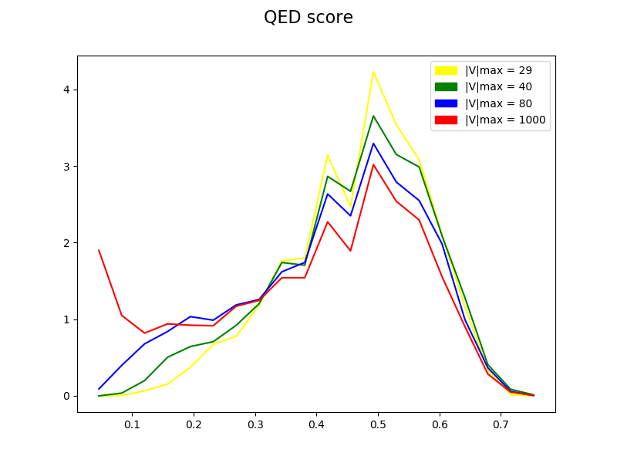
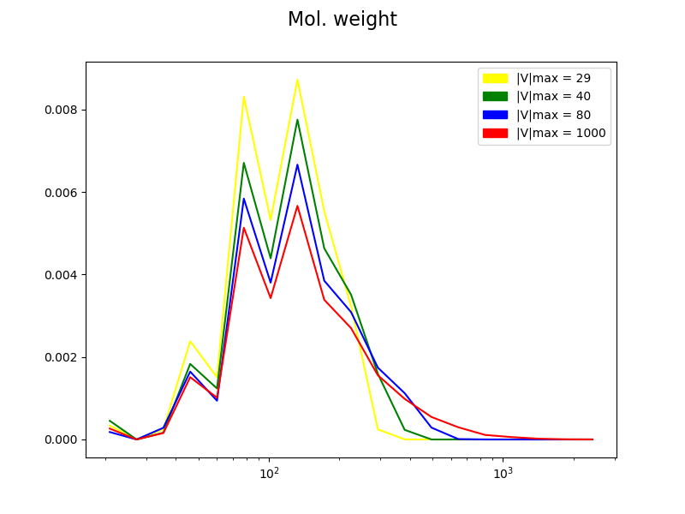
Preliminary Results
A first set of experiments was dedicated to select the best size threshold for the generated graphs (|V|_{max}). Going beyond the maximum size of QM9 compounds (29) yields more valid molecules, but their properties diverge from those of the validation set.

Slide 17
Optimization Phase
A small grid search allowed to optimize other parameters (number of epochs, number of units), obtaining a second configuration C2
A visual inspection (confirmed by numbers) of the generated graphs highlighted a lack of aromatic rings
This is due to a highly unbalanced supervision distribution over the classes of P3 (97% predictable edges are not to be generated)
To increase the number of aromatic rings, we trained an optimized version of the M3 GNN module, obtaining configuration C3
C3 generates more aromatic rings, but C2 still performs better, due to a large number of errors from the M3 module

Slide 18
Generated Material from C2

Slide 19
Generated Material from C3

Slide 20
Experimental Results
A comparison was carried out with other models for the unconditioned generation of molecules, over the metrics presented in [8]
GrammarVAE [11] is the best SMILES-based VAE on QM9
MolGAN (RL-based) is the best sequential model on QM9
GraphVAE is the best graph-based VAE (and state of the art)for unconditioned generation on QM9

Slide 21
Conclusions
Our sequential generative model, based on the capability of GNNs in processing a partially generated graph, has shown competitive performances with respect to other models for unconditioned generation on QM9
More challenging problems/datasets can be addressed, with more atom types and larger molecules (we will stop explicitly generating hydrogen)
Conditioned generation allows to generate molecules with desired properties (specified as an input vector on the whole graph)

Slide 22
Thank you!
Question time

Slide 23
References
[1] Categorical Reparameterization with Gumbel-Softmax (https://arxiv.org/abs/1611.01144)
[2] A* Sampling (https://arxiv.org/abs/1411.0030)
[3] Statistical theory of extreme values and some practical applications (https://ntrl.ntis.gov/NTRL/dashboard/searchResults/titleDetail/PB175818.xhtml)
[4] GANS for Sequences of Discrete Elements with the Gumbel-softmax Distribution (https://arxiv.org/abs/1611.04051)
[5] Learning Latent Permutations with Gumbel-Sinkhorn Networks (https://arxiv.org/abs/1802.08665)
[6] Neural Machine Translation with Gumbel-Greedy Decoding (https://arxiv.org/abs/1706.07518)

Slide 24
References
[7] Convolutional Networks with Adaptive Inference Graphs (https://arxiv.org/abs/1711.11503)
[8] GraphVAE: Towards Generation of Small Graphs Using Variational Autoencoders (https://arxiv.org/abs/1802.03480)
[9] Prediction of physicochemical parameters by atomic contributions (https://pubs.acs.org/doi/10.1021/ci990307l)
[10] Quantifying the chemical beauty of drugs (https://www.nature.com/articles/nchem.1243)
[11] Grammar Variational Autoencoder (https://arxiv.org/pdf/1703.01925.pdf)
[12] MolGAN: An implicit generative model for small molecular graphs (https://arxiv.org/abs/1805.11973)

Slide 25
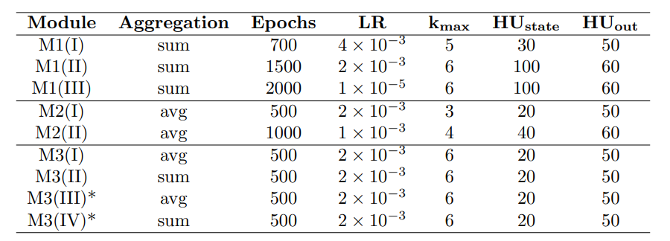
Extra 1: Hyperparameters

Slide 26
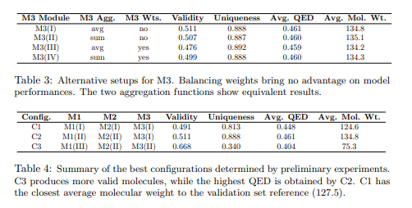
Extra 2: Weights and Configurations

Slide 27
Extra 3: Metrics
Evaluation metrics from [8]:
Validity = Valid/Generated molecules
Uniqueness = Unique/Valid molecules
Novelty = Novel/Unique molecules
To summarize these three values, we can use:
VUN = Novel/Generated molecules

Slide 28
Extra 4: Chemical Properties
QED score [9] measures the “drug-likeness” of generated molecules
logP [10] measures the solubility in polar and non-polar compounds
The molecular mass can be used for an additional comparison with the validation and test sets
Heavier molecules tend to be less “drug-like”

Slide 29
Extra 5: Sorting Issues
Training on every possible node permutation maximizes generalization, but it is far from possible
A node ordering has to be determined for training operations (common problem)
Breadth First Search is the best option, as it allows to expand the graph more evenly
Many permutations are still possible. They can be reduced by determining an atom type order. According to Freeman Betweenness Centrality: H,F,O,N,C

